Slide 1
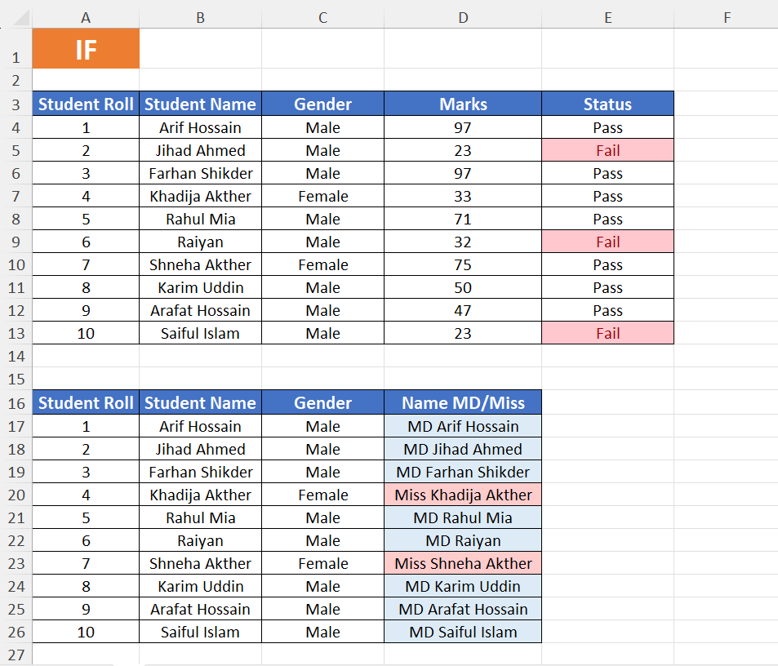
IF Function
Logical

Slide 2
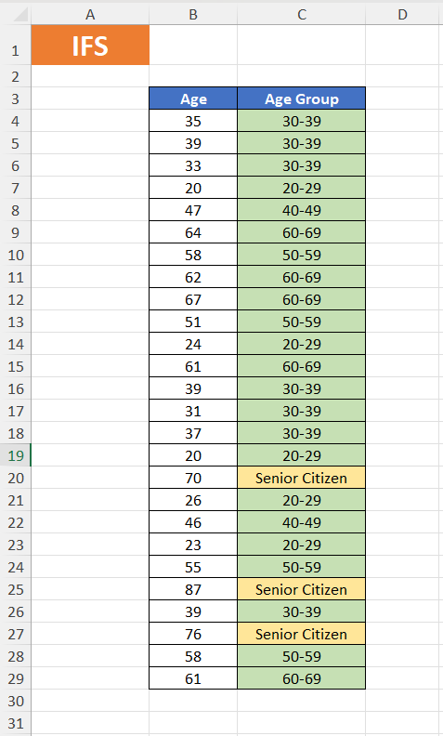
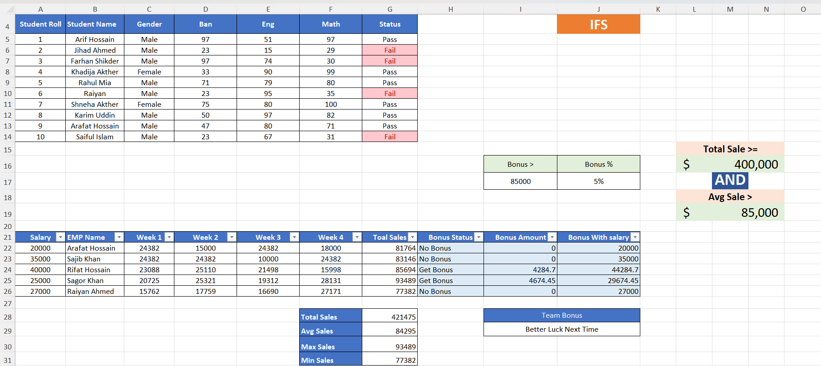
IFS Function
Logical

Slide 3
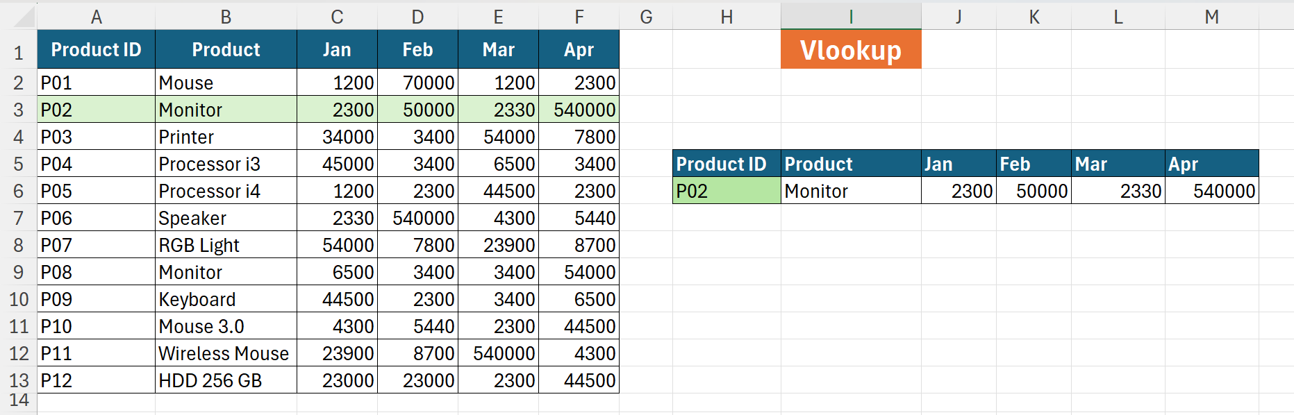
VLOOKUP Function
Lookup

Slide 4
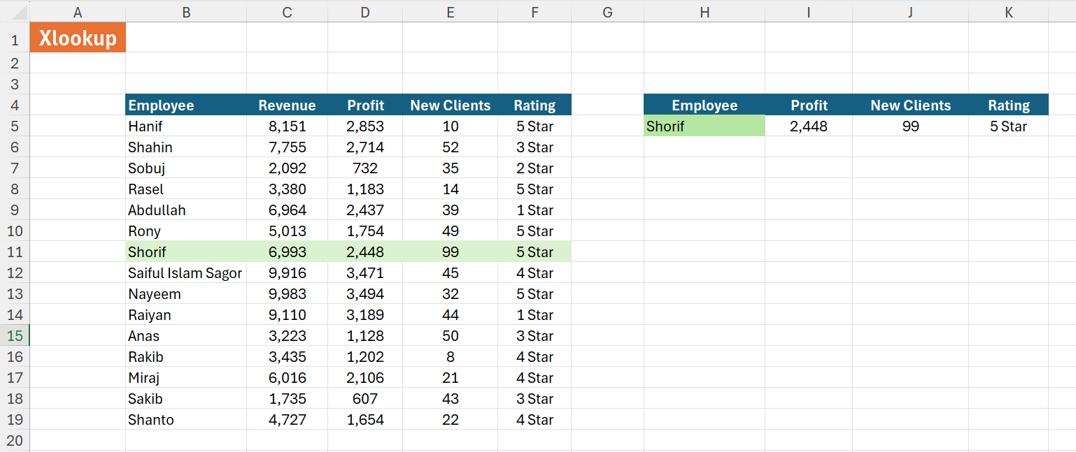
XLOOKUP Function
Lookup

Slide 5
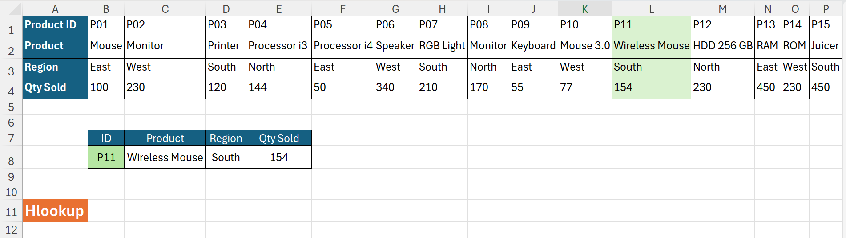
HLOOKUP Function
Lookup

Slide 6
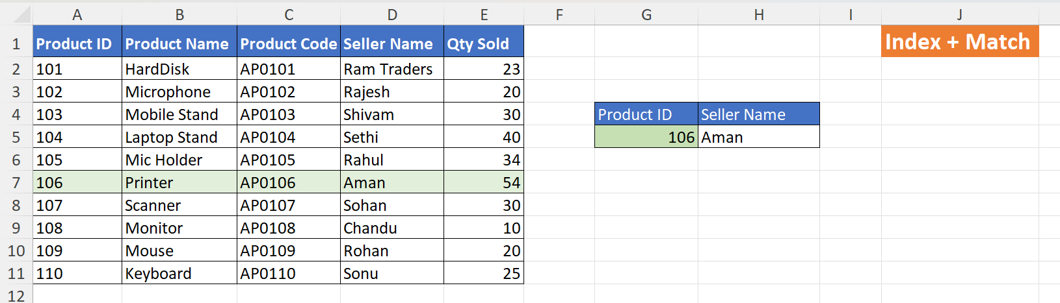
INDEX + MATCH
Lookup

Slide 7
Functions at a Glance
LOGICAL FUNCTIONS
IF
IFS
=IF(test, value_if_true, value_if_false)
=IFS(cond1, val1, cond2, val2, ...)
Tests a single condition
Returns one value if TRUE, another if FALSE
Can be nested but gets complex quickly
Tests multiple conditions in sequence
Returns value for first TRUE condition
Cleaner alternative to nested IF
LOOKUP FUNCTIONS
VLOOKUP
XLOOKUP
HLOOKUP
INDEX+MATCH
=VLOOKUP(val, array, col, 0)
=XLOOKUP(val, lookup, return)
=HLOOKUP(val, array, row, 0)
=INDEX(range, MATCH(val, col, 0))
Searches vertically (top to bottom)
Can only look left-to-right
Modern replacement for VLOOKUP
Searches in any direction
Searches horizontally (left to right)
Returns value from a specified row
Most flexible lookup combo
Works in any direction, any column

